Slide 1

Image Captioning with Flickr30k Dataset
Meeting #3
Ye Kyaw Thu Lab Leader, LU Lab., Myanmar
22 June 2025 (SUN)

Slide 2
Table of Content
Flickr30K Dataset Information
Overview
System Workflow & Coding Information

Slide 3
Overview
Image Team အတွက် ၂ရက်လောက် အချိန်ပေး စမ်းဖြစ်ခဲ့
What is Image Captioning?
Automatically generate textual descriptions of images
Key Components:
CNN (VGG16) for image features
RNN (GRU/LSTM) for sequence generation
Multilingual support (English/Myanmar)

Slide 4
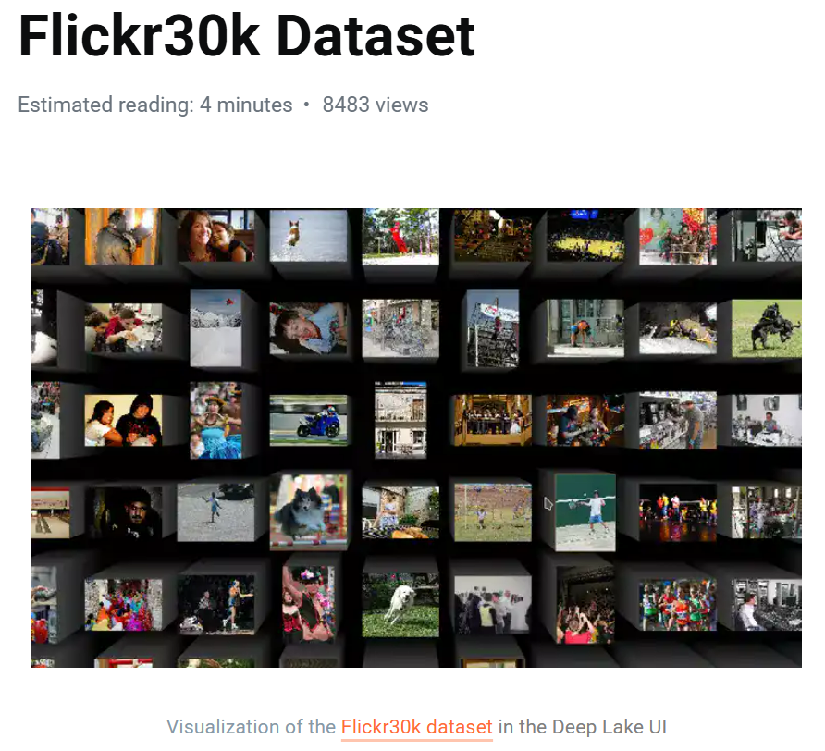
Flickr30K Dataset Information
The Flickr30k dataset is a popular benchmark for sentence-based picture portrayal. The dataset is comprised of 31,783 images that capture people engaged in everyday activities and events. Each image has a descriptive caption. Flickr30k is used for understanding the visual media (image) that correspond to a linguistic expression (description of the image). This dataset is commonly used as a standard benchmark for sentence-based image descriptions.
Link: https://datasets.activeloop.ai/docs/ml/datasets/flickr30k-dataset/

Slide 5
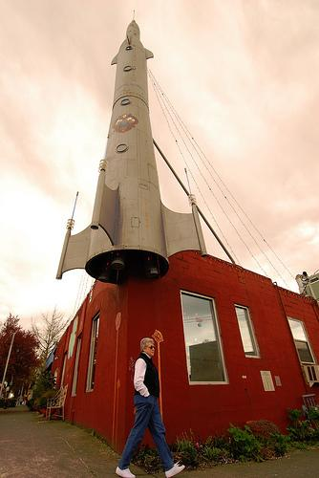
Flickr30K Dataset Information
1. a man prepares to enter the red building .
2. a man walking around the corner of a red building .
3. a man walks past a red building with a fake rocket attached to it .
4. a man walks under a building with a large rocket shaped sculpture .
5. a person walking by a red building with a jet on top of it .

Slide 6
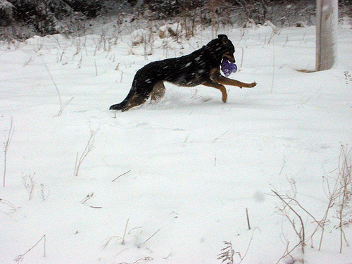
Flickr30K Dataset Information
1. a black dog playing with a purple toy in the snow .
2. a black dog runs through the snow carrying a blue toy .
3. a dog plays in the snow .
4. dog running with a purple toy in the snowy field .
5. the black and brown dog carries a purple toy in the snow .

Slide 7
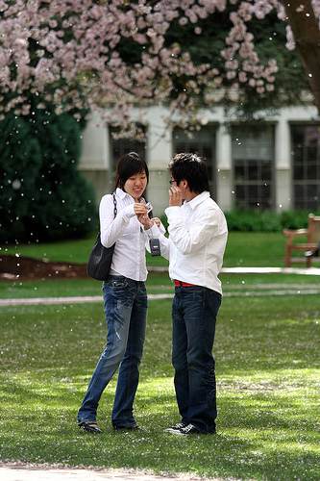
Flickr30K Dataset Information
1. a guy and a girl , both wearing white shirts and jeans , stand under a flowering tree .
2. a man and a woman are talking in a park
3. a man and woman standing underneath the tree are talking .
4. a man in a white shirt is standing in the grass showing something to a woman in a white shirt .
5. a young couple both wearing white shirts and blue jeans standing in a light misty rain

Slide 8
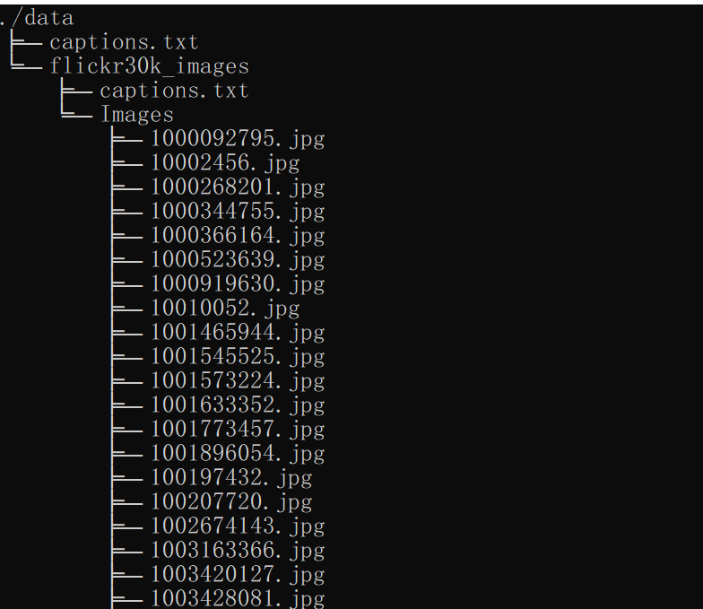
Flickr30K Dataset Information
Folder structure of Flickr30k
Label ဖိုင် နှစ်ဖိုင် ရှိတယ်
Images ဖိုလ်ဒါအောက်မှာ ID နဲ့ သိမ်းထားတဲ့ image ဖိုင်တွေ ရှိလိမ့်မယ်

Slide 9
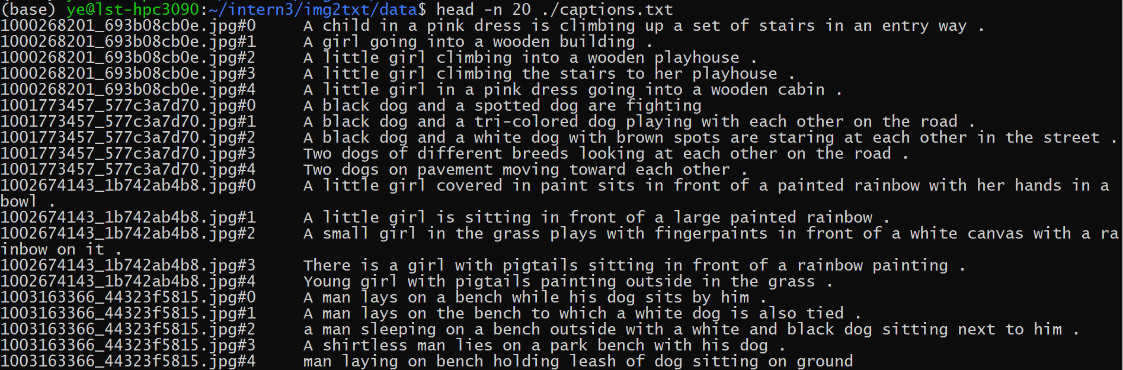
Flickr30K Dataset Information
Fig. Flickr80k style

Slide 10
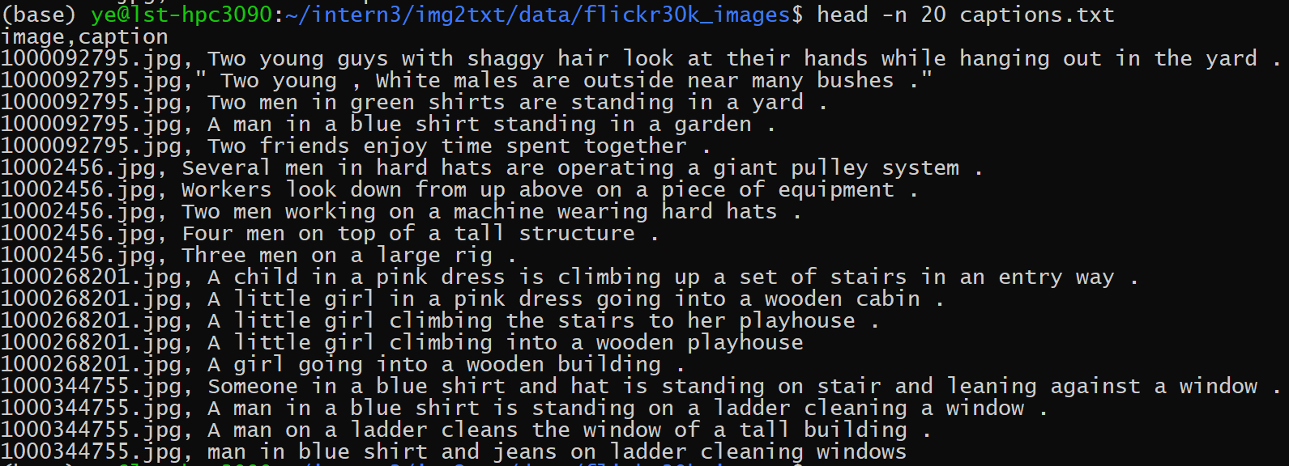
Flickr30K Dataset Information
Fig. Flickr30k style

Slide 11
System Workflow
Visual Flow: Image → VGG16 (Feature Extraction) → GRU/LSTM (Caption Generation)
Key Modules:
Data loading
Feature extraction
Model training
Evaluation

Slide 12
Feature Extraction with VGG16
Process:
Resize images to 224x224
Extract 4096-dim features from VGG16’s penultimate layer
Output:
Saved as features.pkl for reuse
Code
features = extract_image_features(image_paths, vgg_model)

Slide 13
Caption Tokenization
Tokenizer
Converts words to integers (e.g., "dog" → 42)
Calculates vocab_size and max_length of captions
Code
tokenizer.fit_on_texts(captions) # Vocab size = 10,000

Slide 14
Train-Test Split
Split Ratio: 90% train, 10% test
Key Code:
split = int(len(image_ids) * 0.9)
train_keys = image_ids[:split]
test_keys = image_ids[split:]

Slide 15
GRU vs. LSTM
GRU (Gated Recurrent Unit):
Fewer parameters → Faster training
Single gate structure
LSTM (Long Short-Term Memory):
More parameters → Better for long sequences
3 gates (input, forget, output)
Code Switch:
if cell_type == 'gru': se3 = GRU(units)
else: se3 = LSTM(units)

Slide 16
Model Architecture
Inputs:
Image features (4096-dim)
Caption sequences (padded to max_length)
Layers:
Embedding → Dropout → GRU/LSTM → Dense
Loss:
Categorical cross-entropy

Slide 17
Training Process
Parameters
Batch size: 24
Epochs: 200
Learning rate: 0.001, 0.002
Code
generator = data_generator(train_keys, features, ...)

Slide 18
Evaluation Metrics
Metrics Used:
BLEU (1-4), chrF++, CIDEr, ROUGE (1/2/L)
Semantic similarity (TF-IDF + keyword overlap)
Example Output:
BLEU-1: 0.2292
ROUGE-L: 0.1530
CIDEr: 0.0003

Slide 19
Evaluation Metrics
TF-IDF Cosine Similarity
Converts text to vectors (ignoring stopwords)
Measures contextual similarity via cosine_similarity()
Code
tfidf = vectorizer.fit_transform(all_texts)
sim = cosine_similarity(tfidf[0:1], tfidf[1:2])[0][0]

Slide 20
Evaluation Metrics
Keyword Overlap
Exact word matches normalized by predicted caption length:
Code
len(pred_words & ref_words) / max(1, len(pred_words))
Composite Score
Weighted sum: 0.7 * similarity + 0.3 * keyword_overlap

Slide 21
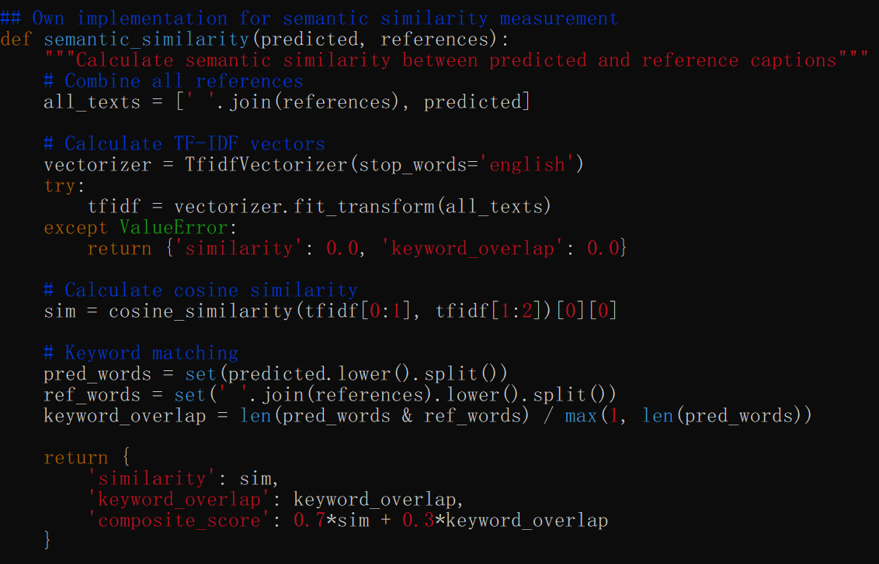
Evaluation Metrics

Slide 22
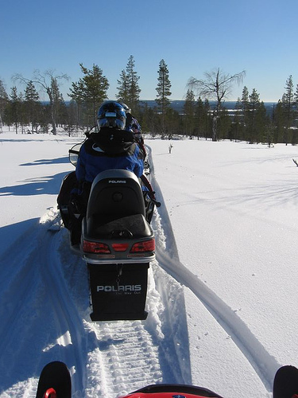
Results Analysis (Good Example 1)
Image ID: 437527058

Slide 23
Results Analysis (Good Example 1)
Image ID: 437527058
Actual: "a caravan of snowmobiles travels through snow"
Predicted: "helmet and dog walking through snow"
Semantic Score: 0.3424 (highest composite score)
Why Good?: Partial keyword overlap ("snow") + contextually plausible

Slide 24
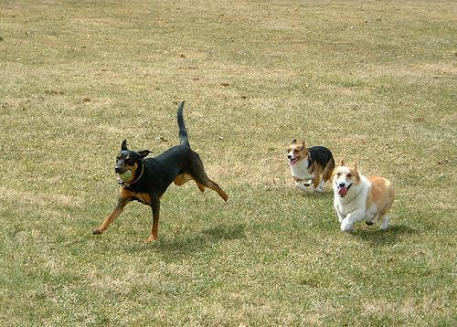
Results Analysis (Good Example 2)
Image ID: 441212506

Slide 25
Results Analysis (Good Example 2)
Image ID: 441212506
Actual: "three dogs playing in a field"
Predicted: "dog with frisbee rolling in grass"
Semantic Score: 0.3059
Why Good?: Captured "dog" and outdoor activity

Slide 26
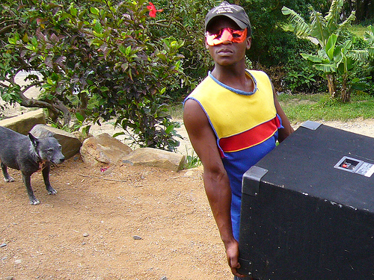
Results Analysis (Good Example 3)
Image ID: 440737340

Slide 27
Results Analysis (Good Example 3)
Image ID: 440737340
Actual: "masked man carrying a box"
Predicted: "tattoos sitting on a bench"
Semantic Score: 0.0321 (lowest)
Why Good?: Complete mismatch

Slide 28
CLI Usage
Commands:
# Train
python image_captioning.py --train --epochs 200 --cell_type gru
# Predict
python image_captioning.py --predict img.jpg

Slide 29
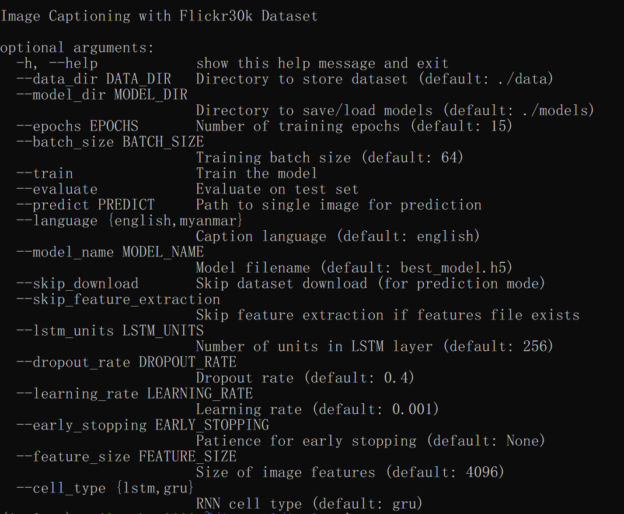
CLI Usage

Slide 30
To Do
Transformer-based models
အချိန်ရတဲ့အခါ လက်ရှိ code ကိုပဲ အခြေခံပြီး Transformer architecture နဲ့ ဖြည့်ရေးတာလုပ်နိုင်
Better Myanmar language support
လက်ရှိ ဒေတာကိုလည်း မြန်မာလို ဘာသာပြန်လိုက်ပြီး အဲဒါကို experiment အနေနဲ့ လုပ်ကြည့်တာမျိုး

